Slide 1



VSCode Plugin Development for Automotive App Deployment
Software Engineering Project – Team Bosch.io
Leipzig, 28.09.2023
Maximilian Nerlich, Carlo Pötter, Martin Hoffmann & Leonardo d‘Angelico

Slide 2
PROJECT OUTLINE
THE ROLE OF BOSCH.IO & THE ECLIPSE FOUNDATION
Bosch.io as intermediary between Eclipse Foundation & Us
Bosch.io has strategic Open Source collab with Eclipse Foundation
We develop for Eclipse Foundation
Bosch.io: Mentoring, technical guidance, project mediation
Eclipse Foundation as an Industry Open Source Incubator
Eclipse IDE, Jakarta EE, and 415+ open source projects
Industry standards & hub for strategic Open Source innovation
Embraced by industry leaders (like Bosch.io)

Slide 3
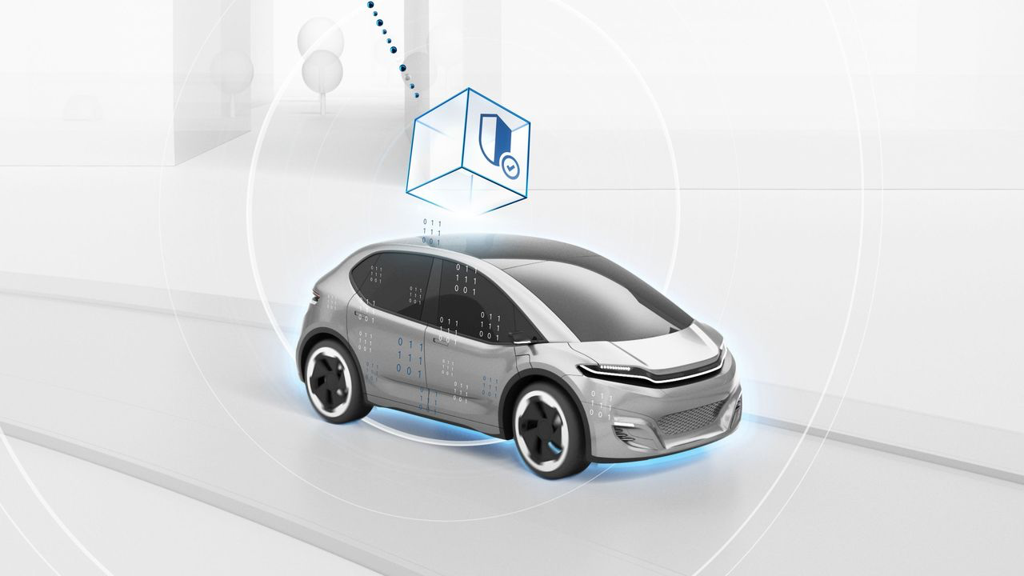
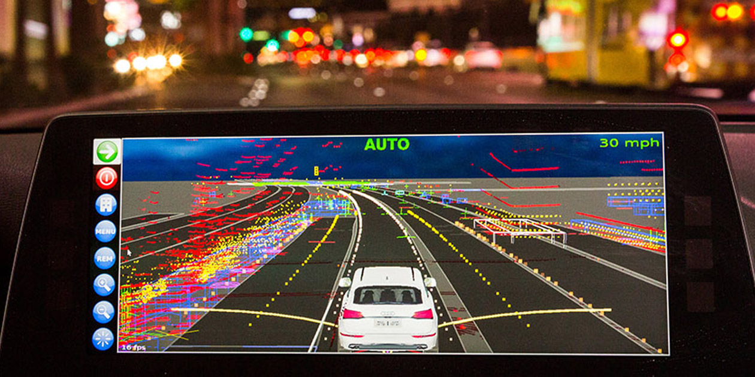

PROJECT OUTLINE
WE CONTRIBUTE TO THE Open-Source-PROJECT „ECLIPSE LEDA“
Eclipse Leda: Technology ecosystem for software-defined-vehicles (SDV)
Aims to bring various components of SDV together
Linux-based distribution with Software stack to deploy applications on vehicles
In-Vehicle-App Container-Image
deploy

Slide 4
TASKS
Development Flow Today
5. Download container image
MQTT
refine process
understand initial process
define architecture for new process
implement new process for JetRacer
test hardware
implement plugin for LEDA
test plugin with LEDA on JetRacer
contribute Plugin to OpenSource project
code compliance
legal compliance
PR
Notes:
just to give a first brought overview

Slide 5


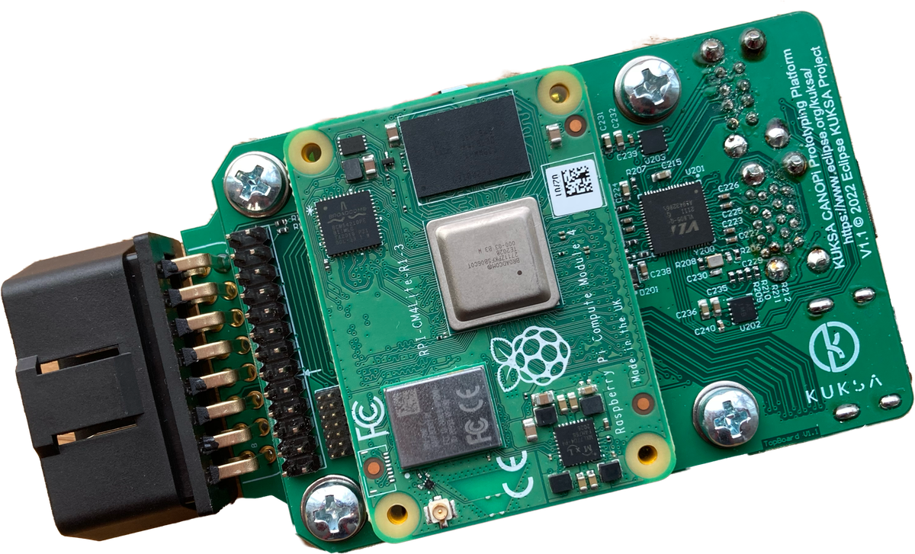



1. a) INITIAL PROCESS
Development Flow Today
5. Download container image
MQTT
3. Build image remote via Pipeline
2. push code
5. Pulls image from internet
In-Vehicle App
1. Develop In-Vehicle-App
6. Starts container
4. Trigger Pull manually on device

Slide 6
1. b) INEFFICENCIES IN INITIAL PROCESS
Development Flow Today
5. Download container image
MQTT
3. Build image remote via Pipeline
2. push code
5. Pulls image from internet
In-Vehicle App
1. Develop In-Vehicle-App
6. Starts container
4. Manual Adjustments on Vehicle Config

Slide 7
1. b) PROBLEM SPACE
Manual Adjustments on Vehicle
Advanced Infrastructure Knowledge
Dependencies
Security
Error-intense
Remote Build Tools
Time Overhead
Internet

Slide 8
1. b) SOLUTION SPACE
….
Manual Adjustments on Vehicle
Process automation via VSCode Plugin
Solution

Slide 9


1. b) OPTION: THE LOCAL BUILD (NO INTERNET REQUIRED AT ALL)
Development Flow Today
5. Download container image
MQTT
2. Build local image
Verbessern Leo
In-Vehicle App
1. Develop In-Vehicle-App
4. Start container
3. Copy Image via local network

Slide 10
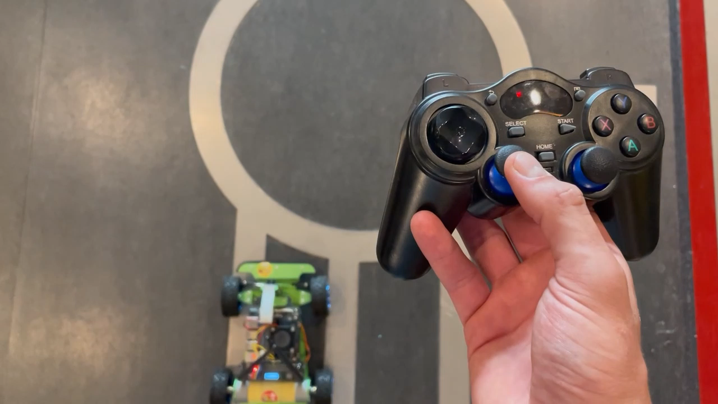
2. a) TEST HARDWARE
JetRacer AI Kit B
Jetson Nano
Waveshare Jetson Nano Dev Kit
Jetracer image
Notes:
- this is the hardware we got initially
- we deployed jetracer image ourselves to check hardware
- actual goal to deploy to LEDA didnt work since image is not working properly on JetRacer

Slide 11

2. a) IMPLEMENT PLUGIN
see GitHub board
Platzhalter für schönen Screenshot

Slide 12
2. c) TEST PLUGIN WITH LEDA ON JETRACER
this did not work
LEDA is not running on the hardware
on the simulation it did work

Slide 13
3. CONTRIBUTE TO OPEN SOURCE
this did work
code compliance
legal compliance
PR

Slide 14
PROJECT OPERATIONS & ORGANISATION
Team Bosch.IO

Slide 15
PROJECT OPERATIONS & ORGANISATION
Onboarding
development organisation
interactions
specific activities

Slide 16
1. ONBOARDING
clarification of project environment
Support from Bosch.io:
contact to Eclipse
Project Management tool suggestions
communication of required skills
Notes:
clarification of project environment:
- already talked about in the beginning
Support from Bosch.io:
- contact to Eclipse
- Developer meeting with presentation of Plugin
- Project Management tool suggestions
- team model canvas to get started
- SCRUM as framework
communication of required skills
- required skills were partly communicated by max and johannes

Slide 17
2. DEVELOPMENT ORGANISATION
SCRUM as template
what we kept:
roles: PO, SM, DEV
events: Sprint, Planning, Refinement, Retro
artefacts: Backlog, Sprintbacklog
deviation:
no clear distinction between roles
no daily
additional regular events: pair programming, presentations, preparations
special events: presentation for eclipse devs
Notes:
WHAT WE KEPT – WHY DID WE KEEP THEM?
- clear meeting schedule with clear goals for each meeting -> more efficient time usage
- Role PO: one responsibility for providing requirements (Johannes)
- Backlog & SprintBL for efficient time management:
- always having enough tickets to work on -> constant workload instead of peak and off times
- measurable: Tickets per Sprint -> better motivation / planning possible
… was it useful? Absolutely!
DEVIATION – WHY NOT USE THEM?
- too few people to have a separate Dev Team, SM and PO
- Daily would've been too much -> 2 meetings per week enough
… did we miss them? Absolutely not!
ADDITIONAL REGULAR EVENTS: Why we keep them? Usefulness? Adjustments?
- pair programming: getting better solutions in shorter time, super useful also for motivation
- presentation on Mondays: for updates and to practice, we didnt attend anymore when we did not have to present anything
- preparations: to get everyone one the same page before meetings
SPECIAL EVENTS:
- presentation for eclipse devs: presenting our plugin to the people that are going to use it – not so helpful

Slide 18
3. INTERACTIONS
… in the group very nice
… with the rest of the company
direct: Johannes & Max
indirect: few devs from eclipse
… what worked
regular meetings
tech support where needed
… what worked not
being on time to every meeting
Notes:
… in group:
- very friendly, trustworthy, reliable, reasonable, open minded, thriving
direct: Johannes & Max:
- friendly, knowledgeable, supportive
indirect: few devs from eclipse
- also very friendly
- no other communication with the rest of company

Slide 19
4. SPECIFIC ACTIVITIES
Requirements elicitation and documentation
requirements well preparated by Johannes
further requirements throughout the project → agile
Concept development
5 Epics were given by Johannes
iterative enhancements
Project status tracking
GitHub
Notes:
Requirements elicitation:
- one big planning at the beginning
- requirements were already quite clear -> good preparation from Johannes & Team
- further requirements on the way -> Refinements and Sprint plannings
- Johannes talked us through possible next steps
- we proposed next steps which we thought had to be taken
documentation:
- Github

Slide 20
PROJECT OPERATIONS & ORGANISATION
Onboarding
development organisation
interactions
specific activities
→ - Overhead of SCRUM at the begining + more structure and efficiency
+ documentation makes our work comprehensible
Notes:
CONCLUSION:
we had overhead for implementing the SCRUM framework, but it gave us more structure and control throughout the project.
PLUS documentation makes our work comprehensible for others -> important in an open source environment
TRANSITION TO NEXT PART: speaking of documentation, we will now show you how we documented our work in detail and how our workflow was in general.

Slide 21
DEVELOPMENT WORKFLOW, ENVIRONMENT & TYPICAL ISSUES
Team Bosch.IO

Slide 22
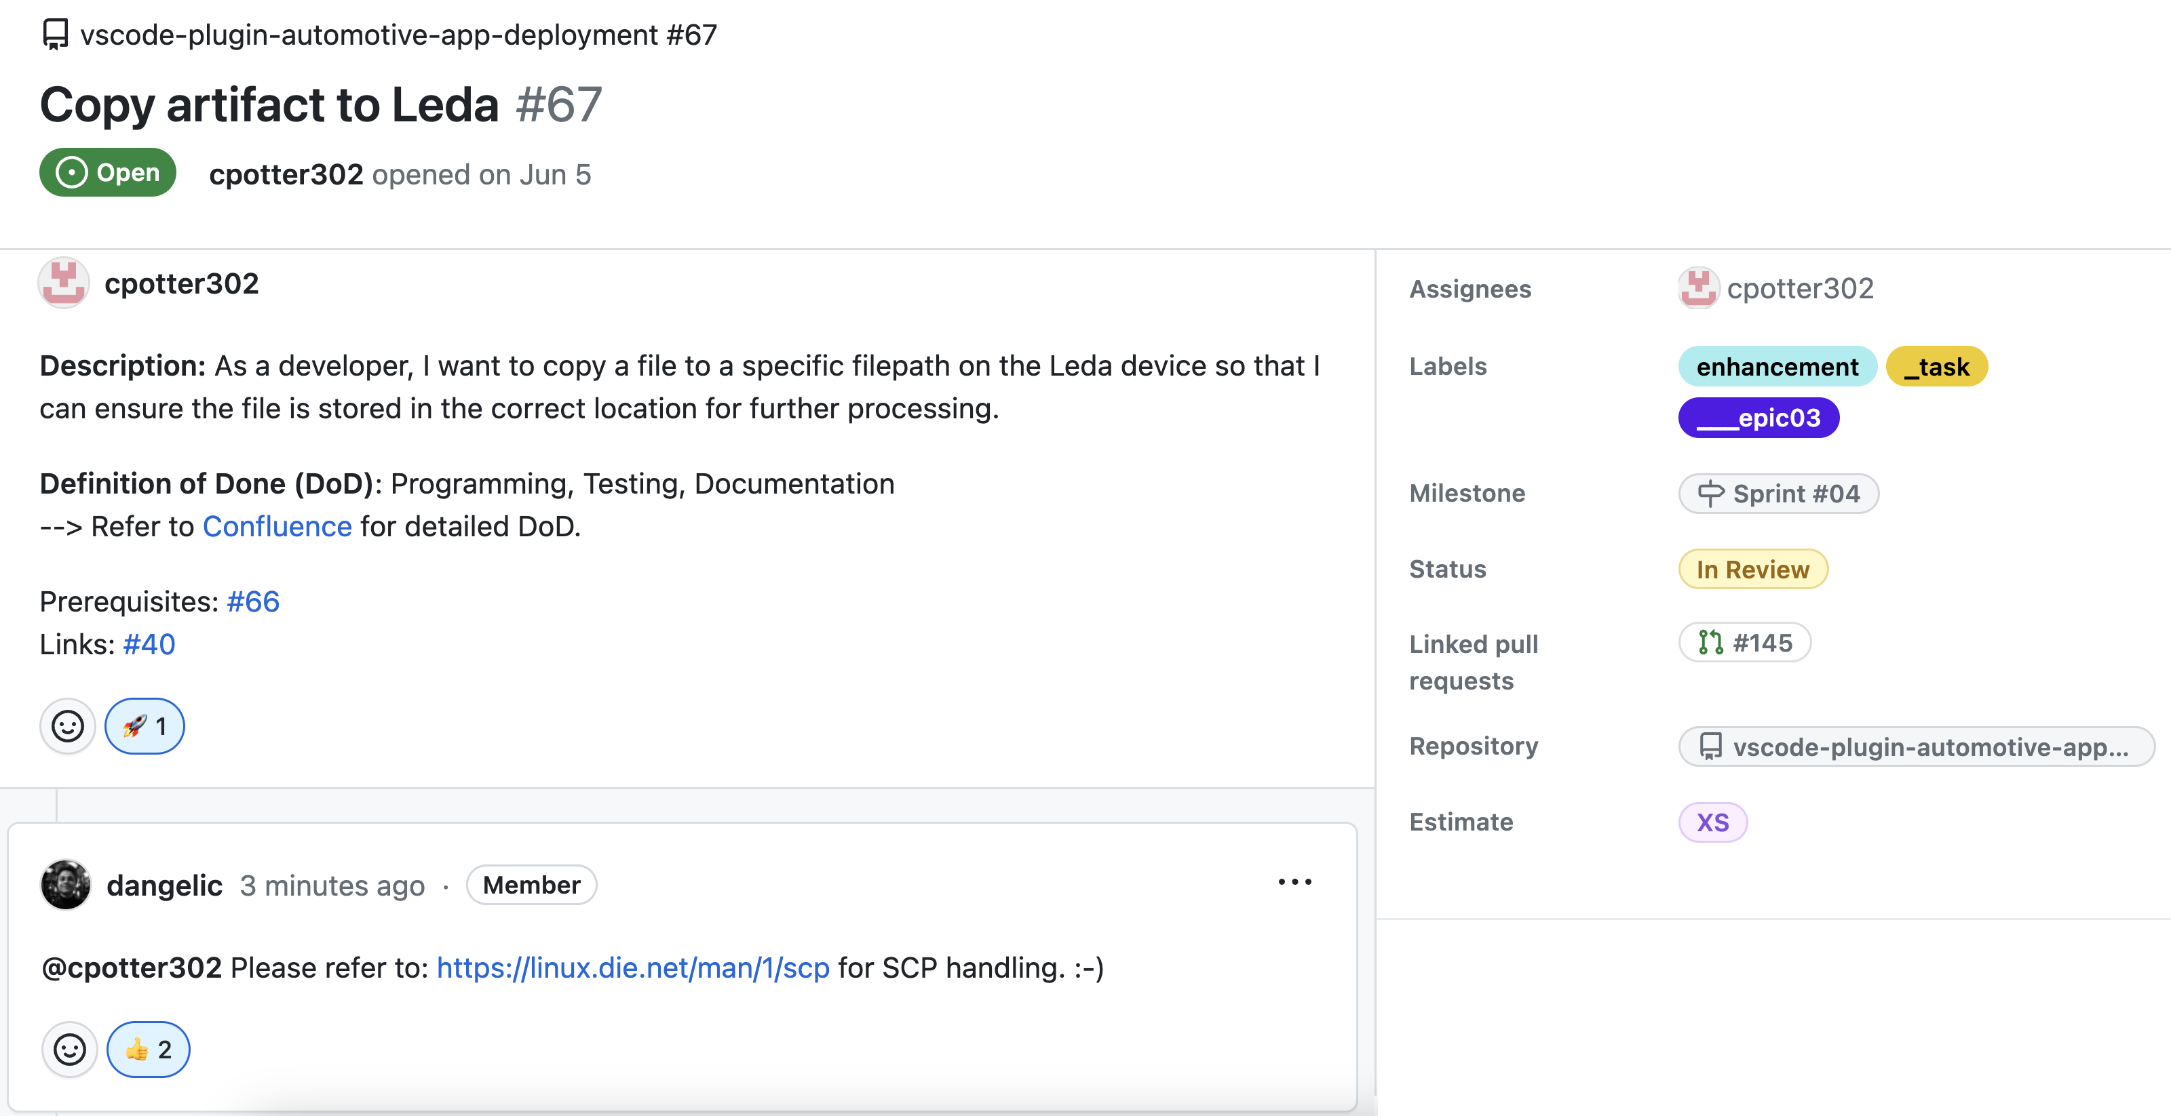
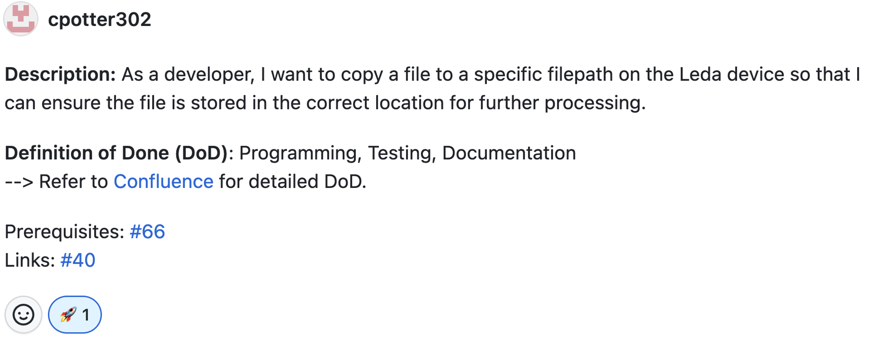
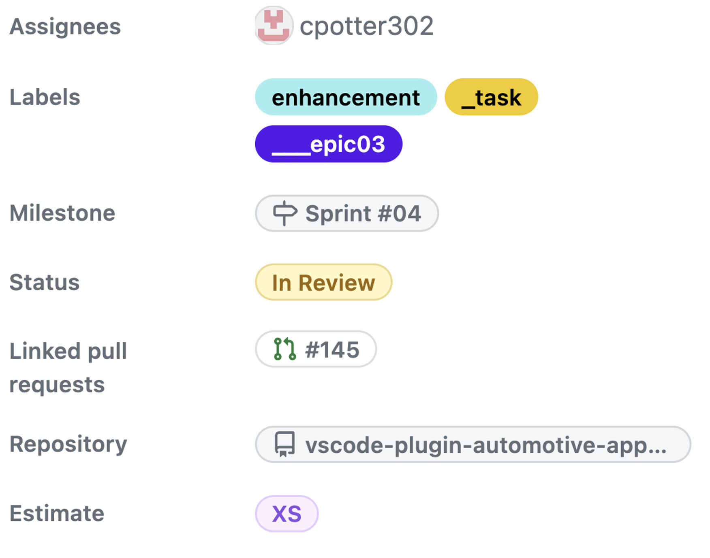
Code Quality

Slide 23





OUR IDEAL DEVELOPMENT WORKFLOW
Write Ticket
Sight Ticket
Implement & Test Feature
Commit & push
Trigger
GitHub- Actions
Open PR
Review PR
Merge PR
Notes:
IMPLEMENTATION TOOLS
- Docker, CLI-Tools, Linter, Formatter,

Slide 24
TYPICAL ISSUES
DEVIATION FROM OPTIMAL PROCESS
Ticket Definition & Communication Issues
Ticket is vagely defined
Estimation not precise enough
Long Review Phases (for PR)
Technical Issues
Fail of Tests or CI/CD Pipelines
Merge Conflicts
Fail of Tests / CI/CD Pipelines
False Review → Bugs on Master Branch
Feature is not implementable
Implement & Test Feature
Trigger
GitHub- Actions
Write Ticket
Review PR
Merge PR

Slide 25
BIGGEST CHALLENGE, HIGHLIGHT & KEY LEARNINGS
Team Bosch.IO

Slide 26


BIGGEST Challenge: BECOME PROJECT-COMPLIENT
COMPLIENCE FOR THE LEDA OPEN SOURCE CONTRIBUTION
Code Compliance
… become a Repository under Project Leda
Legal Compliance

Slide 27
BIGGEST Challenge: BECOME PROJECT-COMPLIENT
CODE Compliance: Source Code has to follow specific project standards.
Code Quality
Style Conventions
Security Standards
Maintainability
Code Quality
Style Conventions
Security Standards
Maintainability
✓ Refactor to TS Clean-Code Guidelines
✓ Use OOP-Design Principles, separate Duties
✓ Use Formatter, Linter & Pre-Commit-Hooks
✓ Emphasize Code Documentation & Readme
✓ Install Dependency Weakness Checker
✓ Seek help: Get Reviews from PO
Notes:
CODE QUALITY: Language Best Practices, KISS,
STYLE CONVENTION: Naming Conventions, Consistent Formatting
SECURITY STANDARDS: Safe Dependencies and Libraries, Security Design Patterns
MAINTAINABILITY: Important because other contributors must understand the logic

Slide 28
BIGGEST Challenge: BECOME PROJECT-COMPLIENT
LEGAL Complience: Code has to follow Open Source Licensing Guidelines.
Contribution License Agreement
Software Licensing
Dependency Licences
Legal Document Stack
Contribution License Agreement
Software Licensing
Dependency Licences
Legal Document Stack
✓ Get familiar with Apache 2.0 and MIT
✓ Sight & Implement Project Rules
✓ Replace / Remove incomplient libraries
✓ Use related Leda Projects as Blueprint
✓ Request Dependency Scan by Eclipse
✓ Seek help: Get assistance from PO

Slide 29
BIGGEST HIGHLIGHT: WE WILL BE PART OF LEDA
… AND THE PROJECT DOES NOT END HERE FOR US
SDV as Future-proven Domain
We simplify SDV Development
But Plugin not tested on Field
Further Development required ➔ We keep Maintaining!
Code Compliance
Legal Compliance

Slide 30
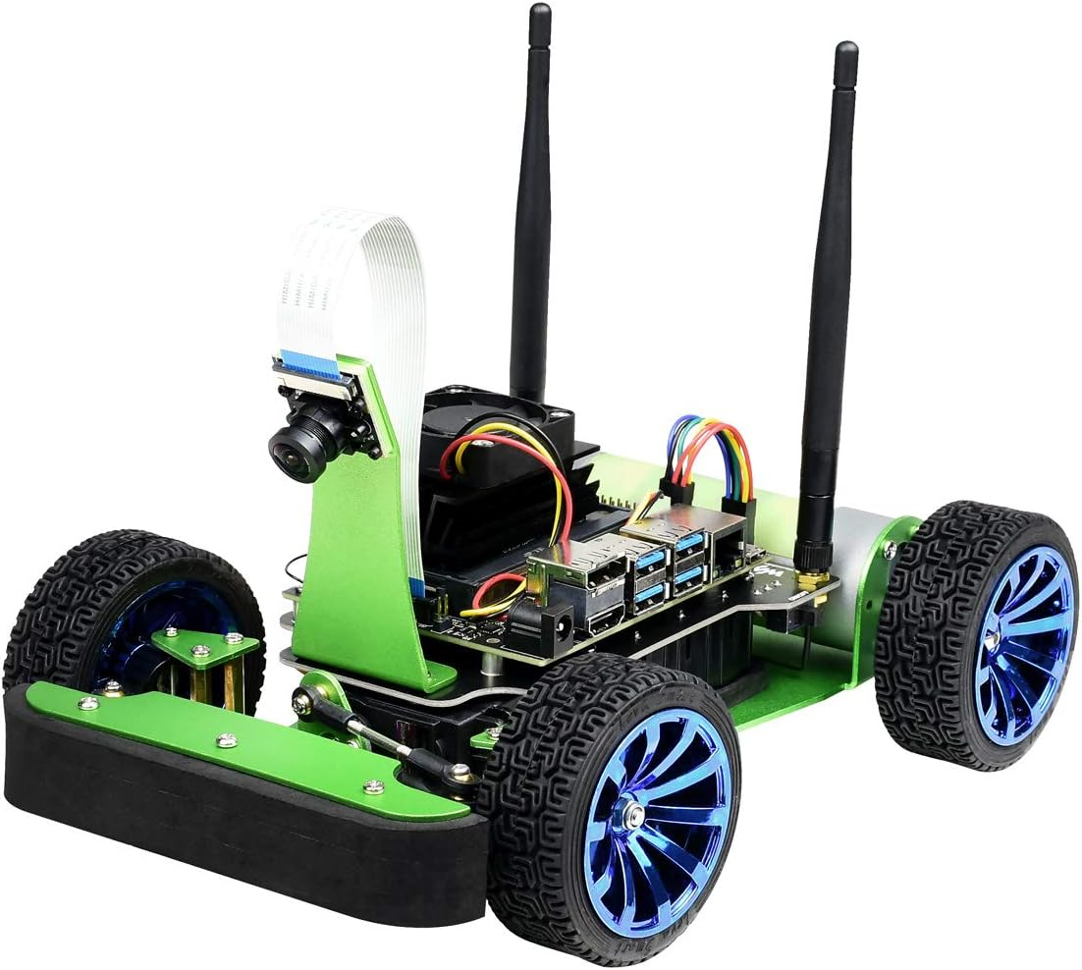
CONCLUSION: WHAT WE HAVE LEARNED
WE COULD ALL ENHANCE OUR SKILLSET IN THIS PROJECT
Technical Perspective
SDV-Development & Toolstack (Leda Environment)
Working in incubating Hightech Project
Development of VSCode Plugin
Project Management Perspective
Collaborative Toolstack on GitHub
Projects with multiple Parties (University, Bosch.io, Leda)
Most important: Team & Time Management
The Open Source Perspective
Code Guidelines
Most unexpected: Various Legal Guidlines & Processes
Notes:
* INCUBATING: We learned that some crucial dependencies might not work in the project

Slide 31
Team Bosch.IO thanks you for the attention! – Q&A
Carlo Pötter, Maximilian Nerlich, Martin Hoffmann & Leonardo d‘Angelico
MSc. Business Information Systems
https://github.com/software-engineering-project-org

Slide 32
Struktur
Ab hier geht’s weiter: → Projektmanagement: @MAX hier nice Story ausdenken mit deinen Punkten aus Miro → Ende deines Teils mit GitHub Issues und einem exemplarischen DEV-Ticket → Dev-Workflow und Tools @Carlo
→ Anknüpfen an exemplarisches Ticket und technische Tools etc. Vorstellen
→ Weitere Punkte: @Leo Open Source, Learnings, Goal Achievement,… AN ALLE: Immer Fazits mit rein, was war gut, was nicht, wieso haben wir was getan

Slide 33
TRENNUNG
AB HIER FOLIEN HINZUFÜGEN

Slide 34
Project Operations & Organisation
xxx
S
X
5 min ca.

Slide 35
Project Operations & Organisation
xxx
S
X
5 min ca.

Slide 36
Textformate
ALLGEMEIN
Fließtext: Schriftgröße 18pt, Zeilenabstand einfach, Schwarz
Aufzählung ab 2. Ebene: Schriftgröße 16pt, Zeilenabstand einfach, Schwarz
Kopf- und Fußzeile: Schriftgröße 12pt, Zeilenabstand einfach, Schwarz
Seitenzahl: Schriftgröße 9pt, Zeilenabstand einfach, Rot
Datumsangabe: Schriftgröße 16pt, Zeilenabstand einfach, Schwarz

Slide 37
Textformate
TABELLEN
Tabellenkopf: Schriftgröße 14pt, Zeilenabstand einfach, Grau (50 % Schwarz)
Erste Spalte: Schriftgröße 14pt, Zeilenabstand einfach, Schwarz
Tabellenangaben: Schriftgröße 12pt, Zeilenabstand einfach, Schwarz
Rahmenlinien: 1pt Grau (50 % Schwarz) und 0,5pt Grau (50 % Schwarz)
 | Tabellenkopf | Tabellenkopf | Tabellenkopf
Wert | Wert | Wert | Wert
Hervorhebung | Wert | Wert | Wert
Wert | Wert | Wert | Wert

Slide 38
Anwendungsbeispiel
TABELLEN
 | Tabellenkopf | Tabellenkopf | Tabellenkopf
Wert | Wert | Wert | Wert
Wert | Wert | Wert | Wert
Wert | Wert | Wert | Wert
Hervorhebung | Wert | Wert | Wert
Wert | Wert | Wert | Wert
Wert | Wert | Wert | Wert
Tabellenunterschrift

Slide 39
Farben
Folgende Farben können für SmartArts, Diagramme,Tabellen und Hervorhebungen verwendet werden (RGB):
Granat: 176 / 47 / 44
Karneol: 214 / 66 / 66
Aquamarin: 138 / 194 / 209
Hellgrau: 201 / 201 / 201
Basalt: 38 / 42 / 49
Es können außerdem Abstufungen der Farbwerte in 20%-Schritten z. B. für Diagramme genutzt werden.

Slide 40
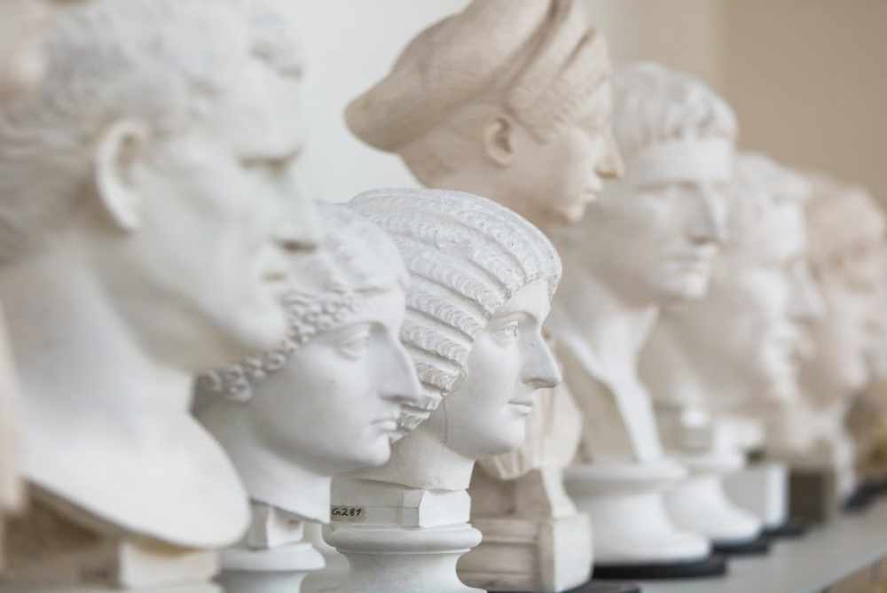
Anwendungs-beispiele
Beispiel für eine Zwischenfolie

Slide 41
Noch Eine Zwischenfolie mit Bild
Untertitel

Slide 42
Zwischenfolie ohne Bild
Untertitel

Slide 43
Anwendungsbeispiel
AUFZÄHLUNG
Hier könnte sich Ihr Fließtext befinden. Fließtexte sind natürlich nicht schlecht – aber in einer Präsentation auch nicht optimal. Haben Sie ein Herz für Ihre Zuhörer und bedenken Sie folgende Tipps:
Lange Texte vermeiden,
Schlagwörter oder kurze Wortgruppen hervorheben,
Aufzählungen verwenden.

Slide 44
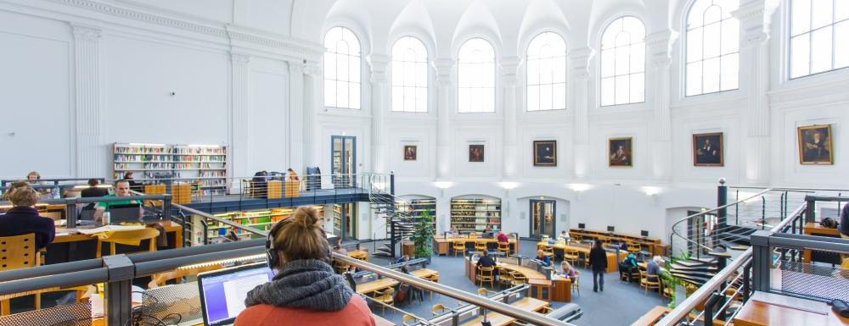
Anwendungsbeispiel
Hier könnte sich Ihre Bildunterschrift befinden – Arial, 12pt, 50 % Schwarz

Slide 45
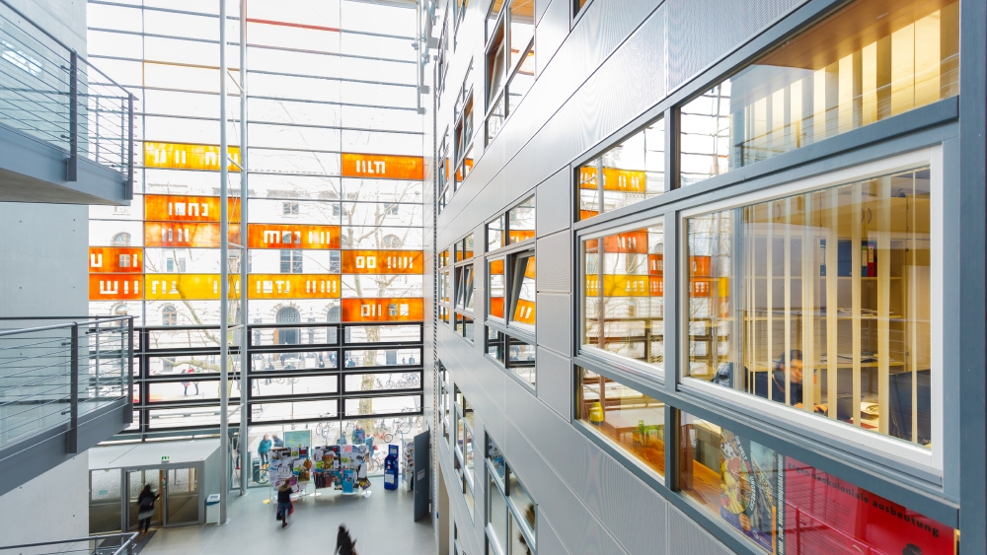

Slide 46
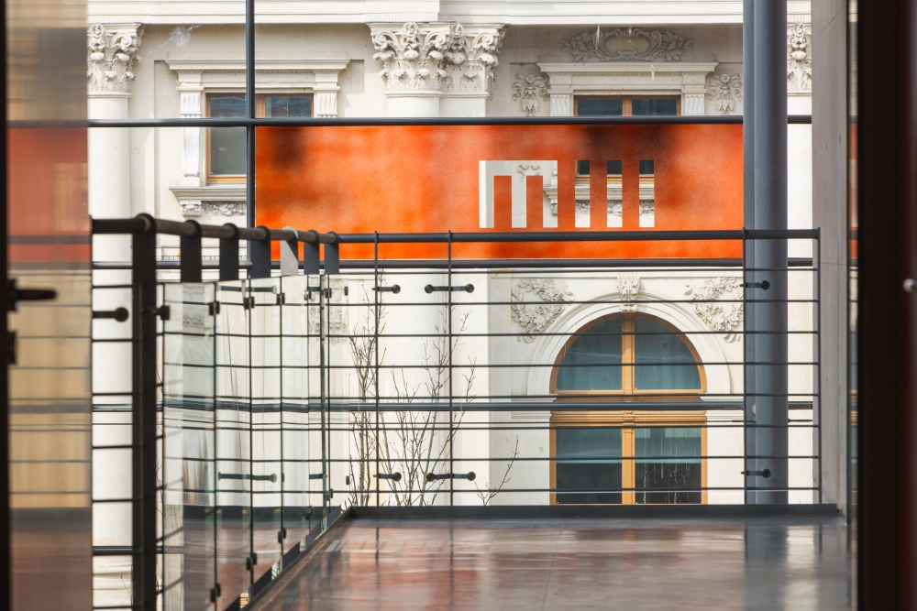
Anwendungs-beispiel
Vergessen Sie bei der Verwendung von Bildmaterial bitte nicht die Angabe der Quelle und vergewissern Sie sich, dass Sie über die nötigen Bildrechte verfügen.
Kennen Sie schon unseren Fotoservice?
Quelle: Universität Leipzig / Name des Fotografen

Slide 47
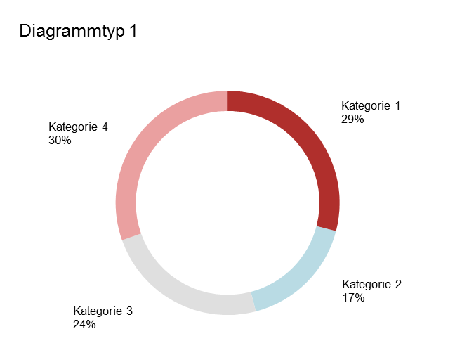
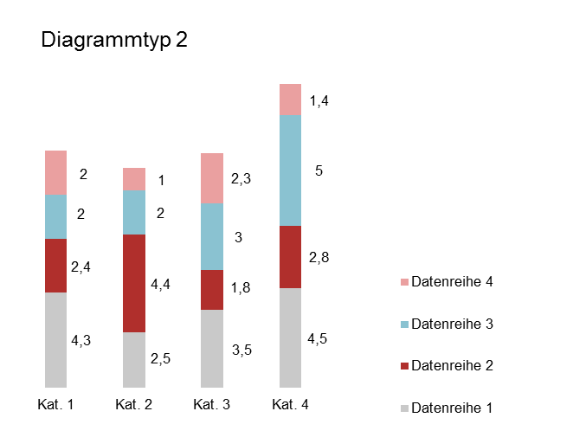
Anwendungsbeispiel
DIAGRAMME
Gesamt
14,8
Abbildungsunterschrift
Abbildungsunterschrift

Slide 48
Vielen Dank!
Name
Einrichtung
Adresse einzeilig
T +49 341 97-xxxxx F +49 341 97-xxxxx
xxx@uni-leipzig.de
www.uni-leipzig.de

